Slide 1
THE SHELL GAME
OR
RIEMANN SUMS REREVISITED
Some solids of revolution are not amenable to the methods we have learned so far (disks and washers).
For example, we may have to compute the volume of the solid of revolution generated by rotating the violet area around the y-axis.
The volume of the solid of revolution generated by rotating about the x-axis is a piece of cake, we just did it in the last presentation! But the y-axis?

Slide 2
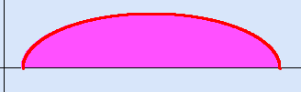


What to do?
Note that the solid you get is (roughly) half a bagel or half a doughnut.
With the wisdom of Riemann sums (and of hind-sight!) we observe that the solid we get can be
thought of as a sum of (more and more, thinner and thinner) “hollow cylinders”, called cylindrical shells
obtained by rotating the Riemann “rectangles”

Slide 3


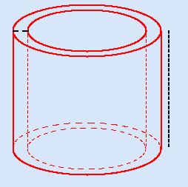

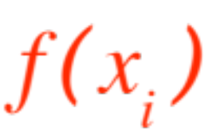
shown in the figure
Each small Riemann rectangle generates, by rotation about the y-axis, a cylindrical shell

Slide 4
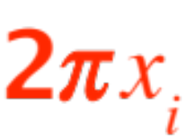
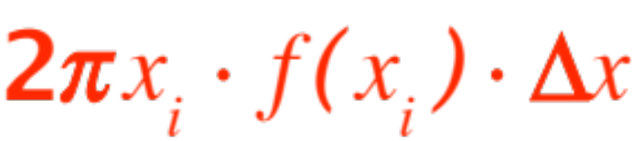
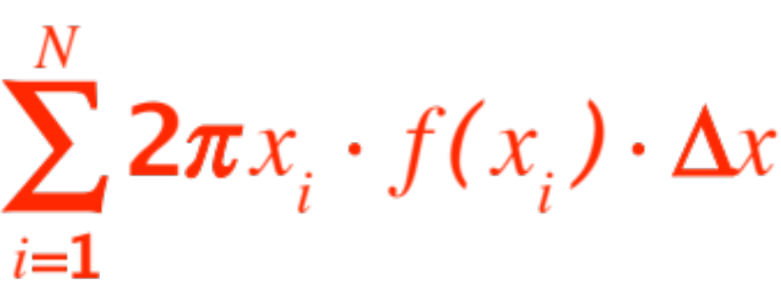
If one “unwraps” the cylindrical shell one gets
(roughly) a parallelopiped with
Height
Base
Width
and Volume
The volume of our solid of revolution (the half bagel!) is therefore the sum of these cylindrical shells. We get the formula
Volume =

Slide 5
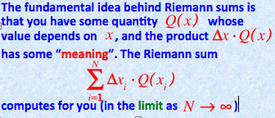
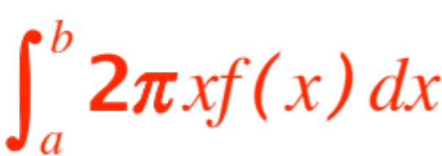
Familiar? Recall our observation
In our case, it computes the volume of our solid, and we can ease the computation via the FTC as
Volume =

Slide 6
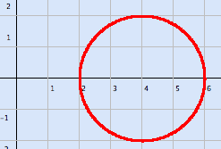
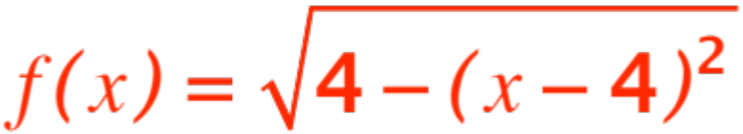
Now life is fun! Let’s compute the volume of a full doughnut, obtained by rotating the circle shown about the y-axis.
Of course, we will
apply our formula
to the figure shown
in the next slide,
with equation
(then double the answer!)

Slide 7
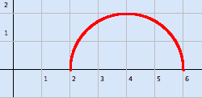
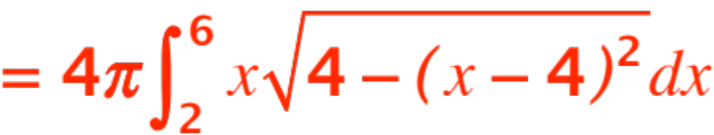
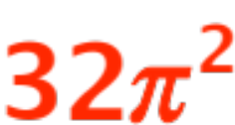
By the formula, volume of doughnut (formally
torus) is
Use substitution and two clever remarks to get the answer

Slide 8
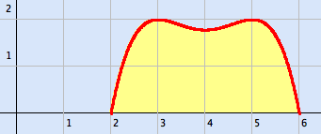
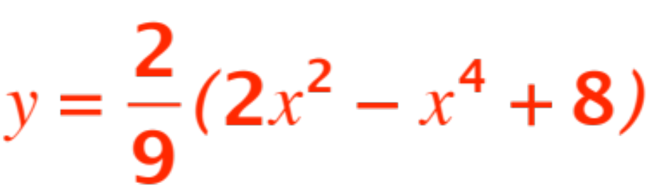
One more challenge: Find the volume of the “grooved” Bundt cake obtained by revolving the area shown in the figure about the y-axis.
The equation of the red curve is

Slide 9
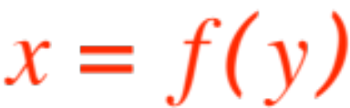
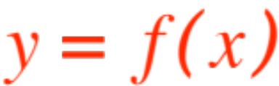
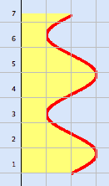
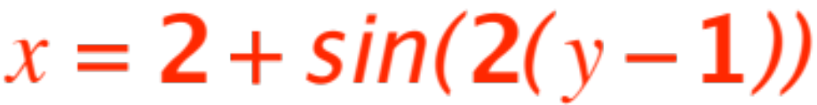
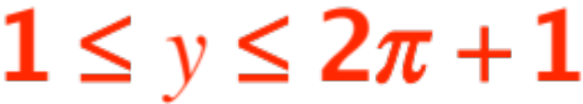
Sometimes one is required to rotate the area bound by the graph of about the x-axis,
but no convenient formula exists.
(see figure)
The red curve has equation

Slide 10


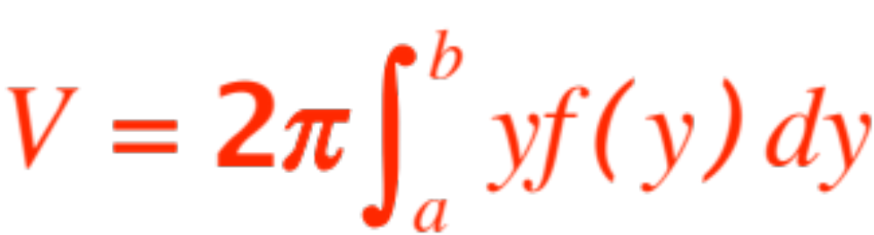
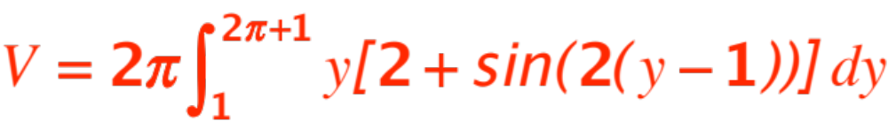
The analysis we just made applies (mutatis mutandis, i.e. exchanging with ) and we get the volume as
For the example shown we get:
Computation of the integral requires integration by parts, to be learned next semester.

Slide 11


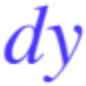




The tables below may be helpful:
Method | Axis of rotation | Integrate in
Disks and Washers | The x-axis The y-axis | (use ) (use )
Cylindrical Shells | The x-axis The y-axis | (use ) (use )

Slide 12
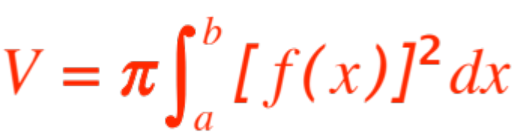
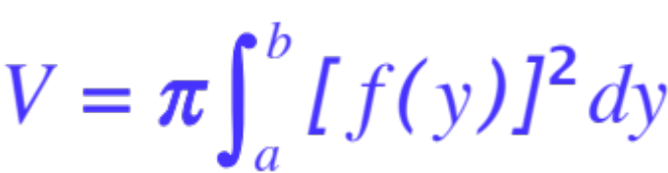

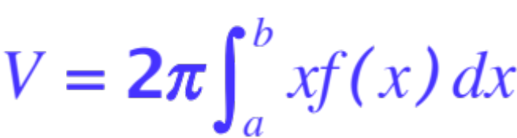
and
Method | Axis of rotation | formula
Disks and Washers | The x-axis The y-axis
Cylindrical Shells | The x-axis The y-axis

